Slide 1
Games Bootcamp Game Managers

Slide 2
Table of contents
01
What Are Managers
04
Power Ups
02
Game Objectives
03
Scoring Systems
You can describe the topic of the section here
You can describe the topic of the section here
You can describe the topic of the section here
You can describe the topic of the section here

Slide 3
01
Game Managers
You can enter a subtitle here if you need it

Slide 4
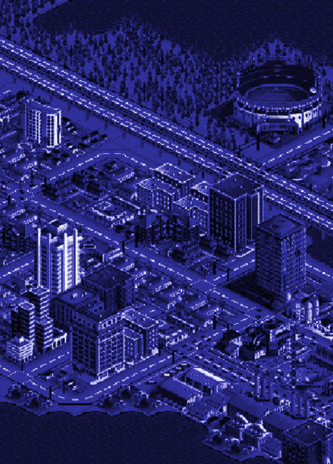
Managers (1)
Central control scripts that manage various aspects of gameplay
Game (State) Manager
Score, Lives, Progression
Scene Manager
loading/unloading levels
AudioManager
Ambient music, SFX

Slide 5
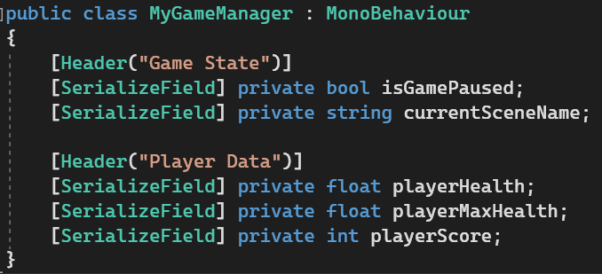
Managers (2)
Managers allow you to decouple information from the player character. This allows you to change characters, models or load new scenes while keeping the data.
Game State: Paused, Current Scene, Game Mode etc
Player Data: Score, Health, Lives, Inventory
Level Data: Difficulty settings, Objective Progression
Session Data: Duration, Time, Location.
Here are some basic fields that you would have:
[] Denotes a ‘Attribute’
These are added to fields to change how they are displayed or used.

Slide 6
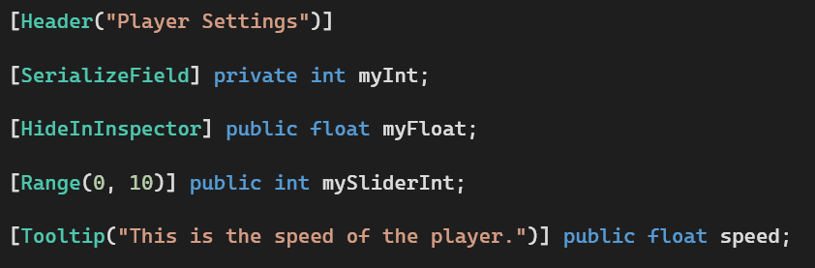
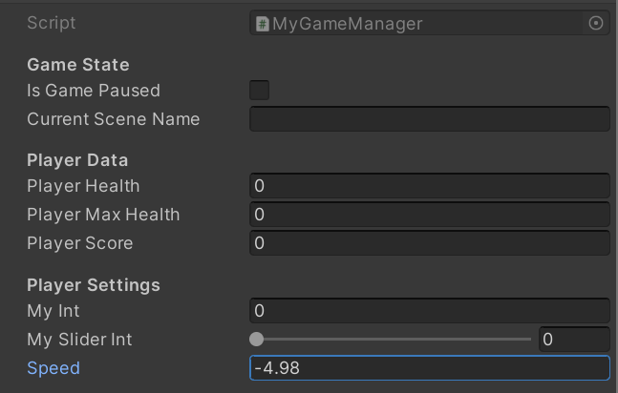
Managers (3)
Attribute:
Inspector:

Slide 7
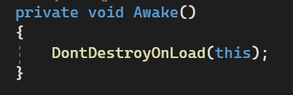

Managers (2)
In order to be useful, Managers should persist over levels. GameObjects by default do not persist of different levels and so we need a function to stop our GameManager being deleted.
‘This’: refers to current version or ‘instance; of this object.
This however creates an issue in trying to reference the game manager.
Notes:
Demonstrate instances

Slide 8
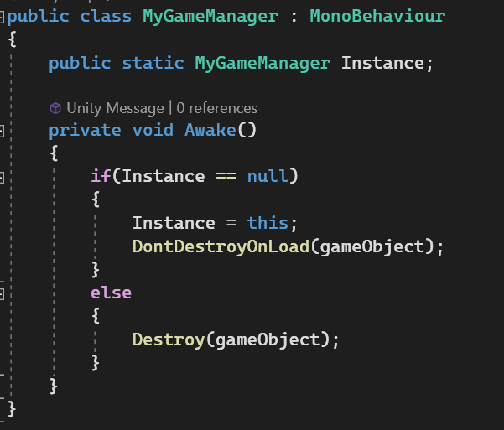

Managers (3)
SINGLETON PATTERN
The pattern is designed to address this issue. There are 2 benefits.
Only one singleton can exist at any time (Instance)
The instance is usually globally accessible.
The field no longer belongs to an instance. It is now ‘static’ and is shared by every instance. A static property will remain in memory until the app is closed.
We are checking if the Instance is ‘null’. On the first go this object will set itself as the instance.
If you load into the scene again you will now have to two GameManagers. But as the Instance has already been set. The second object will just destroy itself.
Notes:
Demonstrate instances

Slide 9
Game Objectives (1)
Objectives are defined mini win/lose conditions. They serve as a fundamental design element that shapes the player's experience and provides structure to the gameplay. Here's a detailed explanation of their role:
Guiding Player Progress:
Clear Direction: They drive progression and can be used to break down larger quests or goals into steps.
Gameplay Focus: Objectives focus players' attention on specific tasks or challenges within the game. They prevent players from feeling lost or aimless by giving them a target to work toward.
Motivation: Objectives serve as motivators. Players are often more engaged and driven to play when they have clear goals to pursue. The anticipation of achieving an objective can be a powerful motivator.
Progression Control: Game designers can use objectives to control the pacing of the game. They can introduce new objectives at key points to keep the gameplay fresh and challenging.

Slide 10
Game Objectives (2)
Defining Win/Lose Conditions:
Win Conditions: Objectives are often directly tied to win conditions. Completing the primary objectives or achieving a specific set of goals can lead to a player's victory. These win conditions create a sense of accomplishment and satisfaction.
Lose Conditions: Objectives can also define lose conditions. Failing to meet certain objectives or allowing specific events to occur can result in a player's defeat or failure. Lose conditions add tension and consequences to the game.
Player Agency: Objectives give players agency over their progress and outcomes. Players must make decisions and take actions to achieve objectives, influencing whether they win or lose.
Varied Challenges: By setting multiple objectives, game designers can create varied challenges and win/lose conditions. Some objectives may be easier to achieve, while others are more difficult, offering different levels of challenge to players.

Slide 11
Game Objectives (3)
Enhancing Player Engagement:
Feedback and Rewards: Objectives provide opportunities for feedback and rewards. When players complete objectives, they often receive feedback in the form of in-game events, notifications, or visual cues. Rewards, such as items, points, or progression, can further motivate players.
Sense of Progression: Objectives contribute to a player's sense of progression within the game. As players complete objectives, they feel a sense of accomplishment and advancement, which can be highly satisfying.
Narrative Integration: Objectives can be used to advance the game's narrative. Story-driven objectives guide players through the plot, ensuring that they experience key story moments and character development.

Slide 12
Game Objectives (4)
Creating Challenge and Complexity:
Strategic Decision-Making: Objectives often require strategic decision-making. Players must prioritize which objectives to pursue first, consider their resources, and adapt to changing conditions, adding depth and complexity to the gameplay.
Puzzle and Problem-Solving: Some objectives may involve puzzles or challenges that require critical thinking and problem-solving skills. These objectives can stimulate players' intellect and creativity.

Slide 13
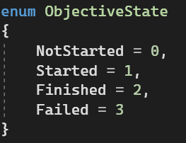
Game Objectives (4)
Very simple objectives can be described with a simple boolean.
However as you up the complexity you may need a more detailed state than yes/no:
‘Enum’ is short for enumeration. They take the words we list and store them as numbers.
This provides us with better readability. Instead of being in state ‘3’ we are in state ‘Failed’

Slide 14
Power Ups (1)
Power-ups are temporary enhancements or abilities within a video game that empower players by providing various advantages or new capabilities for a limited duration. These enhancements are typically collected or activated by players during gameplay and can significantly impact a player's performance, strategy, or progression. Power-ups are a common element in many games and often serve to increase player engagement and enjoyment.

Slide 15
Thanks!

